Slide 1
به نام آنکه جان را فکرت آموخت
دکتر سهیل سلطانی پور
متخصص پزشکی اجتماعی
دانشیاردپارتمان پزشکی اجتماعی
دانشکده پزشکی رشت

Slide 2
prevention= concept of health

Slide 3
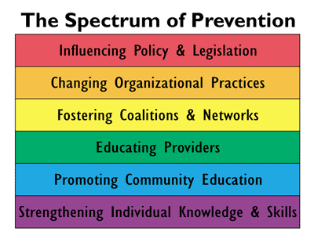

Slide 4
Influencing policy and legislation
?

Slide 5
Changing organizational practices
Periodic examination

Slide 6
Concept of the periodic examination
Patient without symptom can harbor organic disease.
Disease can be detected at an early stage
Discovery of disease can lead to arrest, reversal, retardation, or cure of that disease.
Variations in perceptions and expression

Slide 8
Clinical Preventive medicine
Definition & application

Slide 9
Clinical Preventive medicine
Atlanta, Georgia – 1989.
ACPM
The aerospace medical association
The american college of occupational medicine
American association of public health physicians
Association of preventive medicine residents

Slide 10
definition
Integral part of preventive medicine
Maintenance and promotion of health
Risk assessment and reduction
In the clinical setting

Slide 11
clinical preventive medicine specialist
Assess risk(screening, health risk assessment tool)
Intervention(biologic, behavioral, and environmental)
Organize and manage and be an advocator.
Apply media techniques
Evaluate

Slide 12
Screening
Important health problem
Accepted treatment
Facilities available
Recognizable latent or early symptomatic stage
Suitable test or examination
Acceptable to the population
Adequately understood natural history
Agreed policy on whom to treat as patient
Cost { case finding (diagnosis- treatment) } balanced
Case finding must to be continuing process

Slide 13
Risk assessment tool
Seventh report of the joint national committee on prevention, detection, evaluation, and treatment of high blood pressure(JNC7)
ATPІІІ guidelines at-a-glance quick desk reference
Please search

Slide 14
Thank YOU!

